Slide 1
INTRODUCTION TO VALUATIONS
Real Estate Board
Real Estate Training Institute
Real Estate Salesman Course Eric Allen

Slide 2
Definition of Valuation
Art and /or science of estimating values

Slide 3
Definition of Valuation
Provision of a written opinion as to capital price or value or rental price or value-
on any given basis
in respect of an interest in property
with or without associated information, assumptions or qualifications

Slide 4
Definition of Valuation
It does not include a forecast of value!
There is no “crystal ball”

Slide 5
Definition of Valuation
Valuation is:
simply a model to try to determine price.
value is the end result.

Slide 6
Definition of Valuation
Valuation is:
a quantification of an understanding of the market.
the legal impact
physical constraints
planning regime

Slide 7
Definition of Valuation
Valuation is (cont’d.):
5) the availability of finance
6) the demand for the product
7) the general economy
These all influence the value of property.

Slide 8
Definition of Valuation
In the property market, a “valuation” is the best estimate of the trading or spot price of a property, with or without buildings or structures.

Slide 9
Appraisal
Written provision of a valuation, combined with professional opinion, advice and/or analysis relating to the suitability or profitability of the subject property for defined purposes or to the effects of specified circumstances thereon, as judged by the valuer following relevant investigations.
It may involve a calculation of worth.

Slide 10
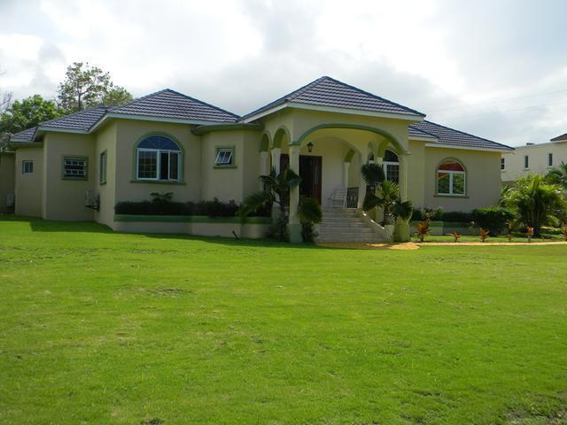
THE HOUSE

Slide 11
THE HOUSE Area of site: 20,000 sq ft. Description of site: level throughout Facilities: 4 bedrooms, 4 bathrooms, powder room, living/dining, kitchen, helpers quarters Area of Building: 2,000 sq. ft.

Slide 12
THE HOUSE Cost of Construction: $40 million ****************************************** Importance of Location: Seymour Lands: $60 million Vineyard Town: $35 million Linstead: $25 million

Slide 13
WORTH
A specific investor’s perception of the capital sum which he would be prepared to pay (or accept) for the stream of benefits [real or inferred] which he expects to be produced by the investment.

Slide 14
PRICE
Actual observable exchange price in the open market: what you actually got when property was sold

Slide 15
VALUE
Estimate of the price that would be achieved if the property were to be sold in the market.

Slide 16
COST
Production-related concept, distinct from exchange, which is defined as the amount of money required to create/construct or produce a commodity, good or service.

Slide 17
COST
Once the good is completed or the service rendered , its cost becomes a historic fact.

Slide 18
Price/Worth/Cost/Value
The difference between these is fundamental to valuation principles and is essential to the supportable estimation of value.

Slide 19
Price/Worth/Cost/Value
In relation to real estate:
value should always be related to price
(value in exchange) not worth (value in use)

Slide 20
Price/Worth/Cost/Value
Price/value are market driven whereas worth is subjective and based on the particular requirements/ circumstances of the individual.

Slide 21
Price/Worth/Cost/Value
In an open and free market, no transaction will be likely if the value in use/worth to the vendor is greater than the value in use/worth to the purchaser.

Slide 22
Price/Worth/Cost/Value
In a perfect market, where all investors have the same information and the same requirements, price and worth should be equal.

Slide 23
Price/Worth/Cost/Value
The property market is not perfect and so there is a natural divergence between price and worth in certain markets.

Slide 24
Price/Worth/Cost/Value
Depending upon the type of property, the valuation may compare previous sales prices and derive an investment value (value in exchange) by reference to observed payments in the market.

Slide 25
Price/Worth/Cost/Value
Whereas other properties, which do not transact sufficiently often to produce reliable comparable information, need to use valuation models which reflect the thought processes of the principal players: this relates to worth (value in use).

Slide 26
MARKET VALUE
in an arm’s length transaction
after proper marketing
wherein the parties had each acted knowledgeably, prudently and without compulsion.
the estimated amount
for which an asset should exchange
on the date of valuation
between a willing buyer and a willing seller

Slide 27
Market Value
The concept presumes a price negotiated in an open and competitive market : also known as open market value
The market for a property could be an international or a local market
The market could consist of numerous buyers and sellers or could have limited participants

Slide 28
Market Value
The market in which the property is exposed is not restricted in any way or constricted.
However, if the word open is not used, it does not mean that the transaction is private or closed.

Slide 29
Market Value
The best way to find out what a property will fetch on the market is by putting it up for sale and accepting the best serious offer.
THE VALUER DOES NOT HAVE THIS LUXURY!
He has to use all available evidence to arrive at a realistic opinion of what the property would fetch in the market.
But it can only be an opinion.
Certain assumptions would have to be made and certain conventions observed in arriving at this opinion.

Slide 30
Market Value
Some salient questions and observations:
(1) Does market value mean the best price that is likely to be obtained in the market at the time or is it an average price in current market conditions?
“The estimated amount” refers to a price expressed in terms of money, payable for the property in an arm’s length transaction. Market value is measured as the most probable price reasonably obtainable in the market on the date of valuation in keeping with the market value definition. It is therefore not typically an average.

Slide 31
Market Value
(2) Property is relatively illiquid and a reasonable marketing period is needed to achieve the best price. Is the marketing period before or after the valuation? This is important if the market has prices moving rapidly up or down.
After “proper marketing…” means that the property would be exposed to the market in the most appropriate manner to effect its disposal at the best price reasonably obtainable in accordance with the market value definition. The length of exposure may vary with market conditions, but must be sufficient to allow the property to be brought to the attention of an adequate number of potential purchasers.

Slide 32
Market Value
(3) Do you assume that the vendor is under a particular time pressure to sell , for example in a liquidation, in which case the price achieved might be a lot lower than that which would be produced with a reasonable marketing period.
“A willing seller…” is neither an over-eager nor a forced seller, prepared to sell at any price, nor one prepared to hold out for a price not considered reasonable in the current market.
He is motivated to sell at market terms for the best price obtainable in the open market after proper marketing, whatever that price may be.

Slide 33
Market Value
(3) cont’d.
“ A willing buyer…” refers to one who is motivated, but not compelled to buy. This buyer is neither over-eager nor determined to buy at any price.
This buyer is also one who purchases in accordance with the realities of the current market and with current market expectations, rather than an imaginary or hypothetical market that cannot be demonstrated or anticipated to exist.
He would not pay a higher price than the market requires.

Slide 34
Market Value
A valuer must not make unrealistic assumptions about market conditions nor assume a level of market value above that which is reasonably obtainable.

Slide 35
Market Value
(4) Do you take account of a more profitable alternative use to which the property in question might realistically be put?
Market-based valuations must determine the highest and best use (HABU), or most probable use of the property asset, which is a significant determinant of its value.

Slide 36
Market Value
HABU is defined as “the most probable use of a property which is:
physically possible
appropriately justified
legally permissible
financially feasible
And which results in the highest value.

Slide 37
Highest and Best Use Principle
Lots 1-4 Moon Path
1 2 3 4
Area: 25,000 sq. ft. each

Slide 38
Highest and Best Use Principle
Lots 1, 2 and 4 are owned by John.
Lot 3 is owned by Mary.
Each lot has a single-family house constructed on it.
Planners will allow townhouses and high-rise apartments in the area, as long as area is not less than ½ acre in size.

Slide 39
Market Value
(5) Do you take account of possible buyers with a special interest in the property, who might be prepared to pay well above the market’s going rate?
An “arm’s length transaction” is one between parties who do not have a particular special relationship, for example, parent and subsidiary companies or landlord and tenant, that may make the price level uncharacteristic of the market or inflated due to a “special value”.

Slide 40
Market Value
The market value transaction is presumed to be between unrelated parties, each acting independently.

Slide 41
Market Value
(6) Does the valuation make allowance for selling costs?
Typically no.

Slide 42
Market Value
(7) “Wherein the parties had each acted knowledgeably and prudently…”
this presumes that both the willing buyer and willing seller are reasonably informed about the nature and characteristics of the property, its actual and potential uses and the state of the market as of the date of the valuation.

Slide 43
Market Value
(7) cont’d.
the willing buyer and willing seller are each presumed to act in self-interest with knowledge and prudently to seek the best price for their respective positions in the transaction.
Prudence is assessed by referring to the state of the market at the date of valuation, not with benefit of hindsight at some later date.

Slide 44
Market Value
(7) cont’d.
it is not necessarily imprudent for a seller to sell property in a market with falling prices at a price that is lower than previous market levels.
the prudent buyer or seller will act in accordance with the best market information available at the time.

Slide 45
Market Value
(8) “…and without compulsion…”
this establishes that each party is motivated to undertake the transaction, but neither is forced or unduly coerced to complete it.

Slide 46
Market Value
In all of the 8 cases outlined above, the figure that the valuation produces could be very different depending on the answer adopted.
These answers will determine the conventions that the valuer will adopt.
Potential conflicts can arise between market value and estimate of value as purchasers are motivated by factors other than purely economic appraisals

Slide 47
Market Value
Valuers do not make the market : they are observers and interpreters.
A potential purchaser who proposes to tie up capital in land and buildings, may view the transaction from 3 positions:

Slide 48
Market Value
owner-occupation: he will be concerned with any anticipated social or commercial benefit;
investment: he may be concerned with the annual return in the form of income derived from the property
speculation: buying at one price with the hope of selling at a higher price in the future, thus having a capital gain.

Slide 49
Market Value
The motives may or may not be mutually exclusive.
The price the purchaser will be prepared to pay at any given time will be influenced by supply and demand for the particular type of property.
Demand must be effective: the desire to possess should be translatable into the action of purchasing.

Slide 50
Market and Non-Market Bases of Value
MARKET BASES OF VALUE
Concept of Market Value is tied to collective perceptions and behaviour of participants in the market.
It recognises diverse factors that may influence transactions in a market
These are distinguished from non-market considerations that affect value
An example of a market based valuation is the sales comparison approach, where the valuer looks at sales of similar properties in the subject area.

Slide 51
Market and Non-Market Bases of Value
NON-MARKET BASES OF VALUE
These valuations consider the economic utility or functions of an asset, other than its ability to be bought and sold by market participants.
For example, insurable value, salvage value and liquidation value.

Slide 52
NON-MARKET VALUATIONS

Slide 53
Value in Use
The value a specific property has for a specific use to a specific user.
Non-market related
This focuses on the value that specific property contributes to the entity of which it is a part
No regard to its highest and best use or the monetary amount that might be realised upon its sale

Slide 54
Investment Value or Worth
The value of a property to a particular investor or a class of investors for identified investment objectives
It relates a specific property to a specific investor with identifiable investment objectives
This is usually associated with special value, an extra-ordinary element of value over and above market value.

Slide 55
Insurable Value
The value of the property in accordance with the definitions contained in the insurance contract or policy

Slide 56
Assessed , Rateable or Taxable Value
Value that is based on definitions contained within applicable laws relating to the assessment, rating and/or taxation of property
The values arrived at do not comply with the accepted definition of Market Value

Slide 57
Salvage Value
The value of a property, excluding land, which is disposed of for the materials it contains, rather than for continued use without special repairs or adaptation

Slide 58
Liquidation or Forced Sale Value
The amount that may reasonably be received from the sale of a property within a timeframe too short to meet the marketing timeframe required by the definition of Market Value.
May involve an unwilling seller
May involve a buyer who buys with knowledge of the disadvantage of the seller

Slide 59
Special Value
Relates to an extra-ordinary element of value over and above market value
This can arise by the physical, functional, or economic association of a property, such as an adjoining property.
An increment of value applicable to a particular owner or prospective owner, rather than to the market at large.
A special value applicable to a purchaser with a special interest

Slide 60
Mortgage Lending Value
Value of a property making a prudent assessment of the future marketability of the property by taking into account long-term sustainable aspects of the property, the normal and local market conditions, and the current use and alternative appropriate uses of the property.
Speculative elements should be excluded.

Slide 61
Purpose of Valuations
It underpins a major proportion of financial decisions in mature economies
Banks use property as collateral for loans
Important element for published company accounts
Failure to ensure assets are properly valued risks financial exposure for a wide range of stakeholders

Slide 62
Purpose of Valuations
House-buyers
Whole economies that depend on stable banking systems
Pension funds

Slide 63
Requests for Valuations
Sale
Purchase
Mortgage
Insurance
Lease/Rental
Financial Reporting
Statutory Purposes
Probate
Property Tax
Land Acquisition
Rent Restriction
Transfer Tax

Slide 64
The Valuation Report
The term “valuation” suggests a mathematical process
A large part however depends on the valuer forming an opinion
This is based on professional training and experience gathered over the course of his career
Determination of market value requires transactional market data

Slide 65
The Valuation Report
The formal presentation of the valuer’s opinion in writing must contain, at a minimum, the following:
A sufficient description to properly and clearly identify the property
A definition of value
A statement as to the interest being valued
Legal encumbrances that may affect the value
The effective date of the valuation
Any special features of the property
The name of the valuer

Slide 66
Valuation Accuracy and Standardisation
Once stable market conditions obtain and provided market information is available to all:
the difference of opinion should not be great between competent valuers and
between the valuation and subsequent sale price of properties.
A few court cases have noted wide variations between valuations (in excess of 10%) for the same property .

Slide 67
Valuation Accuracy and Standardisation
In the United Kingdom, the property crash of the 1970s was largely blamed on a wide variation in the approach to valuations which gave vastly different and often completely unrealistic figures for similar assets.
Standards were introduced to codify the basis on which valuations can be produced.
In Jamaica, the Real Estate (Dealers and Developers) Act has introduced a minimum qualification for Valuers and additionally, some valuers hold international accreditation from the Royal Institution of Chartered Surveyors (RICS) or the Appraisal Institute in the USA (MAI).

Slide 68
Role of the Valuer
A valuer should be consulted where persons are contemplating transactions involving land and buildings, to advise:
a vendor on the price to sell
a mortgagee (lender) on the value of the security
a person who has received a notice under compulsory powers
a purchaser on the price to pay

Slide 69
Features of the Property Market
A valuer is required due to the special characteristics of landed property:
Imperfections in the property market :
the nature of landed property
the method of conducting transactions
the lack of information generally
available on transactions

Slide 70
Features of the Property Market
(2) The heterogeneity of landed property and the interests which can exist therein:
structural differences in buildings
each piece of landed property is unique by reason of location
the majority of transactions in the property market are conducted privately: detailed information not always available, as to state of buildings and tenure.

Slide 71
Features of the Property Market cont’d.
degree of imperfection does differ in different parts of the market
retail units in shopping centres, offices in purpose-built business parks, townhouses and apartments are fairly homogenous:
this increases the comparability of
these units with each other.

Slide 72
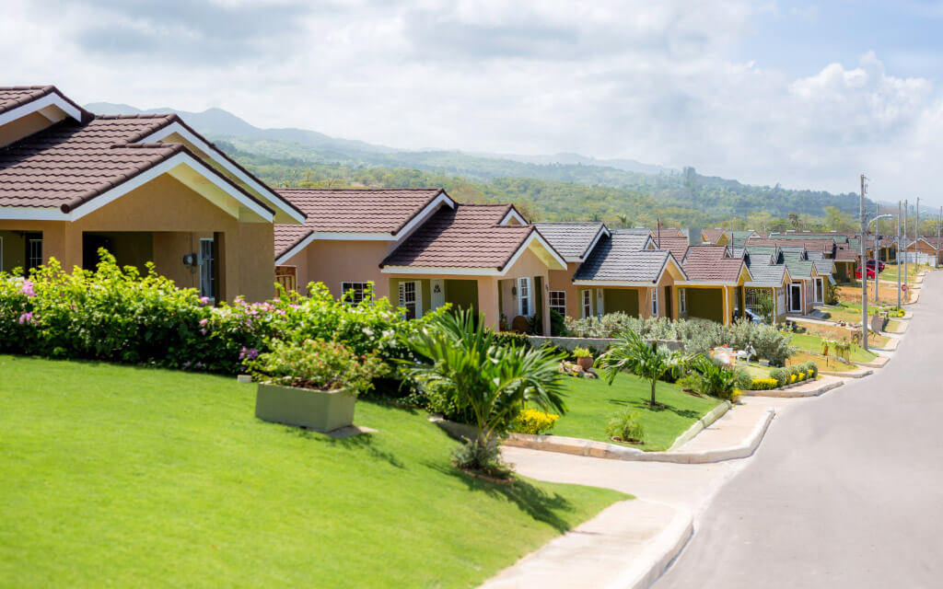
Scheme Houses- 3-bedroom, 2 bathroom, living/dining, kitchen, laundry

Slide 73
Features of the Property Market cont’d.
important to note that the property market is not a single entity
it is composed of a number of sub-sectors:
local/national/international
residential/ commercial/ agricultural, etc
Residential properties required for occupation would normally form part of the local market

Slide 74
Features of the Property Market cont’d.
The property market also categorises property transactions by various property types, for example:
residential market with its sub-
market of townhouses,
detached units and
apartments.

Slide 75
Features of the Property Market cont’d.
A person looking for a house to live in is rarely indifferent to its location because it must be conveniently situated usually in relation to:
place of work,
educational facilities for children and
other facilities such as shopping, church, etc.

Slide 76
Government Intervention
Various pieces of legislation can have an impact on ownership of land/property as an investment and could erode property values after purchase.
For Example: Rent Restriction or Land Acquisition or environmental legislations can have an impact on the value of property

Slide 77
Valuation Process
The process will consist of:
defining the property and interest to be valued
determining the purpose for which the valuation is required
inspection of the property
investigating the legal rights and restrictions, easements, tenancies, etc

Slide 78
Valuation Process cont’d.
determining planning requirements and considerations
classifications of comparable transactions
adjusting of price established from comparable evidence to reflect any locational or physical differences in the property, as well as any pertinent trends in the economy.

Slide 79
METHODS OF VALUATION
Comparable or Sales Method
Investment Method
Cost Approach or Contractor’s Method
Residual (Development) Method
Profits or Accounts Method

Slide 80
METHODS OF VALUATION
COMPARABLE OR SALES COMPARISON METHOD
Used for most types of property where there is good evidence of previous sales
Non-specialised property

Slide 81
METHODS OF VALUATION
COMPARABLE OR SALES COMPARISON METHOD
How much are houses being sold for in this area or a similar location?

Slide 82
METHODS OF VALUATION
INVESTMENT METHOD
Used for most commercial and residential property that is producing , or has the potential to produce, future cash flows through the rental/letting/leasing of the property or through the operation of a business
Non-specialised property

Slide 83
METHODS OF VALUATION
INVESTMENT METHOD
Block of apartments owned by one person
5 x 2-bedroom units
Rental of $100,000.00 per
month

Slide 84
METHODS OF VALUATION
COST APPROACH OR CONTRACTOR’S METHOD
Used for properties not normally bought and sold on the market
Specialised property

Slide 85
METHODS OF VALUATION
COST APPROACH OR CONTRACTOR’S METHOD
How much will it cost me to construct a 200 sq. ft. house?
Add to that the value of the land.

Slide 86
METHODS OF VALUATION
RESIDUAL (DEVELOPMENT) METHOD
Used for properties ripe for redevelopment or for bare land only
Determines the value of the asset undeveloped relative to the potential sale price of the completed development
Non-specialised and specialised property

Slide 87
METHODS OF VALUATION
RESIDUAL (DEVELOPMENT) METHOD
If I developed this site with 10 townhouses, how much can I :
sell the townhouses for? A
how much will it cost to construct
the townhouses? B
A – B = Residual Value
Maximum developer will pay for the site

Slide 88
METHODS OF VALUATION
PROFITS METHOD OR ACCOUNTS METHOD
Used for trading properties (other than normal shops) where evidence of rent is slight as they tend not to be held as investments
The method determines an appropriate rent, which is then used in the investment method

Slide 89
METHODS OF VALUATION
The manner in which property would ordinarily trade in the market would generally decide the applicability of the various methods of estimating Market Value.
When based on market information, each method is a comparative method.
In each valuation situation, one or more methods are generally representative of open market activities.
The valuer will consider each method in every Market Value engagement and will determine which is the most appropriate method or methods.

Slide 90
METHODS OF VALUATION
The adoption and application of the respective method of valuation depends on the following:
the purpose of the valuation
the property and type of interest
physical and other features of the property
the availability of relevant data
government regulations

Slide 91
SALES COMPARISON METHOD
Entails making a valuation by directly comparing the property under consideration with similar properties which have been sold, finding its value from these transactions.
This sounds simple, but it has a lot of pitfalls to trap the unwary.
Comparison must be made with similar properties, situated in the same area and transactions in the recent past.

Slide 92
SALES COMPARISON METHOD
The less the comparative property complies with these requirements, the less valid will be the comparison, or
The greater the number of subjective adjustments that need to be made, the less the valuation can be defended
Often a valuer can get evidence of sales that do accord with the requirements
For example, an apartment or townhouse will have similar features

Slide 93
SALES COMPARISON METHOD
The more uncommon the property is, or the more specialised a property is, the less likely it is for the valuer to find a good comparable.
It is not unusual for there to be a complete lack of evidence of sales of comparable properties
Even when properties appear to be similar, close inspection often reveals that they are in fact different
A row of physically identical houses may on internal inspection prove to have differences

Slide 94
SALES COMPARISON METHOD
The skill and experience of the valuer will be required to make allowances in monetary terms for such differences
A skilled valuer will be able to quantify the difference in value based on the valuer's assessment of empirical data.

Slide 95
SALES COMPARISON METHOD
Procurement of data is of the utmost importance:
source of data: Titles Office
Details of transactions: full details of sales will not always be known; use a range of comparables
date of agreement is important: there may be time lags between date of agreement and registration of sale
Where rental values are known, capital values can be derived by the investment method.

Slide 96
INVESTMENT METHOD
Based on the principle that annual values and capital values are related to each other and that, given the income a property produces or its annual value, the capital value can be found.
Method is used when properties which produce an income flow are to be sold to purchasers who are buying them for investment purposes

Slide 97
INVESTMENT METHOD
That is, the property is purchased primarily for its income bearing capacity
This method involves the determination of a net rental income and then a multiplier is applied (known as years purchase- which comprises a rate of interest and the relevant time period)

Slide 98
INVESTMENT METHOD
Rental income can be actual or notional
Actual: where the property is rented, the actual rental being paid by the tenant
Notional: where the property is owner-occupied, the rental that the property could fetch on the open market.
Many properties are rented on terms which require the landlord to bear the cost of certain outgoings
Outgoings are expenses related to the property that are essential to the property maintaining its full value

Slide 99
INVESTMENT METHOD
Landlord/Lessor’s outgoings:
repairs
insurance
management
rates and taxes
Net Income is arrived at by deducting outgoings from rent paid.
Service charges are not a part of the landlord’s outgoings.

Slide 100
INVESTMENT METHOD
The multiplier (the years purchase) is derived from an interest rate and therefore it reflects the quality of the investment in comparison with other properties and other investments generally
The multiplier also reflects the risk of the investment
The purchaser in considering the investment has regard to:
Capital security
Income security
Income growth
Ease of sale and management
Return on other investments

Slide 101
INVESTMENT METHOD
An analysis of previous transactions is a pre-requisite for the investment method
The comparative principles are at the heart of the process
This method involves estimating future income flows and converting these income flows to capital values

Slide 102
PROFITS METHOD OR ACCOUNTS METHOD
This method is not used where it is possible to value by means of comparison
Generally used where there is some degree of monopoly attached to the property
This is based on the assumption that the values of some properties will be related to the profits or annual returns which can be made from their use

Slide 103
PROFITS METHOD OR ACCOUNTS METHOD
Legal monopoly: where some legal restraint exists to prevent competition to the property user from the user of other property
For example, where a licence is required to carry on a particular trade, such as a licence to sell alcohol, or to run a betting shop or a gas station.

Slide 104
PROFITS METHOD OR ACCOUNTS METHOD
Factual monopoly: some other factor which restricts competition.
For example, Dunns River Falls or Fort Charles, Port Royal

Slide 105
PROFITS METHOD OR ACCOUNTS METHOD
Where there is an element of monopoly, it is not possible to use the comparative method of valuation
The valuer attempts to estimate the rental value of a property in order to derive the capital value
Profits are made on an annual basis and any figure obtained from them will be on an annual basis.

Slide 106
PROFITS METHOD OR ACCOUNTS METHOD
The method is based on the following:
GROSS EARNINGS
less WORKING EXPENSES
is equal to GROSS PROFIT
less TAX
is equal to NET PROFIT PER ANNUM

Slide 107
PROFITS METHOD OR ACCOUNTS METHOD
Allowances must be made from net profit for interest on capital sums expended
Figure derived can be converted to a capital sum by using a multiplier which should be market derived.

Slide 108
COST OR CONTRACTOR’S METHOD
Method used to value properties for which there is little or no sales evidence or
Where property cannot be valued by reference to its trading potential
Applied to properties which seldom change hands and for which there are few comparables
COST AND VALUE ARE RARELY THE SAME !

Slide 109
COST OR CONTRACTOR’S METHOD
The method is based loosely on the assumption that COST and VALUE are related
Method is used infrequently and is a method of last resort
Basic theory of the contractor’s method:
the cost of the site
plus the cost of the building
gives the value of the land and the building

Slide 110
COST OR CONTRACTOR’S METHOD
Types of Properties for which this method is used:
Hospitals
Town halls
Schools
Libraries
Police stations
Other such public/institutional buildings

Slide 111
COST OR CONTRACTOR’S METHOD
Use not however restricted to those types of buildings
Cost is normally only one factor that may affect demand and supply and therefore value
It is a predominant factor with those types of buildings
Persons could choose to either purchase an existing building or acquire a site and construct a building

Slide 112
COST OR CONTRACTOR’S METHOD
Consideration must be taken of the fact that the structure being valued is not a new building:
adjustments must be made for wear and tear from previous use
might also be obsolescence since original construction
deduction made to allow for both depreciation of the buildings and obsolescence of design

Slide 113
COST OR CONTRACTOR’S METHOD
BASIC VALUATION APPROACH:
Basic Cost of Building
plus Professional Fees, inclusive of GCT
plus Finance Charges
plus Allowance for Profit and
Contingencies
is equal to Cost of Building New

Slide 114
COST OR CONTRACTOR’S METHOD
BASIC VALUATION APPROACH cont’d.:
Cost of Building New
less Allowance for Depreciation &
Obsolescence
is equal to Value of Existing Property
plus Site (land) value of existing property
using sales comparison approach
is equal to Market (capital) Value

Slide 115
COST OR CONTRACTOR’S METHOD
Valuation of properties for insurance purposes use an adapted version of this method:
Basic Cost of Building
plus Professional Fees, inclusive of GCT
plus Contingencies
is equal to Cost of Building New

Slide 116
COST OR CONTRACTOR’S METHOD
There are no finance charges for insurance purposes as it is assumed that the total funds will be available up front
Structure will be valued based on construction technology to be employed
For heritage buildings, the structure will be replaced using elements originally used in the development of the structure or as approved by the relevant authority

Slide 117
RESIDUAL (DEVELOPMENT) METHOD
Method most commonly used to determine the value of properties with development potential
Used to determine the viability of development schemes
Difficulties arise not in the method itself but in estimating the values of the variables that go into the valuation

Slide 118
RESIDUAL (DEVELOPMENT) METHOD
Development schemes may comprise :
New buildings on a greenfield site
New buildings on a cleared site
Redevelopment of sites involving demolition of existing buildings

Slide 119
RESIDUAL (DEVELOPMENT) METHOD
Three (3) main purposes for residual valuations:
(1) To calculate the maximum a developer can afford to pay for a development site for sale in the open market:
the valuation amount would be compared with the asking price to see whether it is worthwhile for the developer to buy the site and do the development

Slide 120
RESIDUAL (DEVELOPMENT) METHOD
(2) To calculate the expected profit from undertaking the development where the developer owns the site.
(3) To calculate a cost ceiling for construction, where land has been acquired and is therefore a known cost and a minimum acceptable profit margin can be decided on.

Slide 121
RESIDUAL (DEVELOPMENT) METHOD
When used to assess the development value of land,
the residual valuation will estimate the maximum
purchase price of the site:
The valuer must first ascertain the expected price that the completed development could be sold for
then deduct the expected total costs of the development, and
include an allowance to cover risk and profit

Slide 122
RESIDUAL (DEVELOPMENT) METHOD
Sale Price of Completed Development
(Gross Development Value) A
Less Total Cost of Development (including profit) B
Equals Residue for Site Purchase C

Slide 123
RESIDUAL (DEVELOPMENT) METHOD
Residual Site Value = Gross Development Value (GDV) – Total Development Costs (including profits)
This produces the value of the site after the development has been completed.

